Slide 1
Fusing surface and satellite-derived PM observations to determine the impact of international transport on coastal PM_{2.5} concentrations in the western U.S.
Brett Gantt and Elizabeth Mannshardt, EPA
Jessica Matthews, NOAA/NCEI
July 19, 2016

Slide 2
EPA
What is the EPA?
The US Environmental Protection Agency is tasked with protecting human health and the environment.

Slide 3
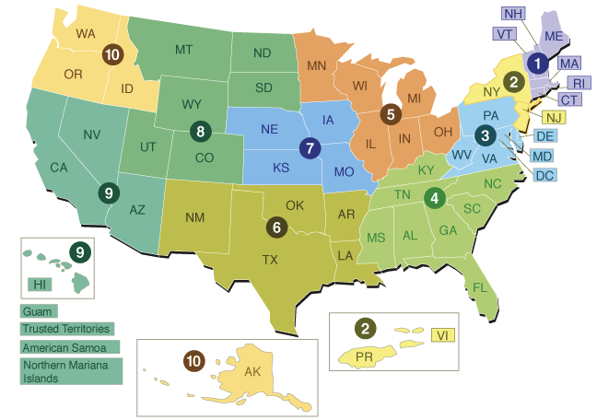
EPA
EPA Offices
Office of the Administrator
Office of Administration and Resources Management
Office of Air and Radiation
Office of the Chief Financial Officer
Office of Chemical Safety and Pollution Prevention
Office of Enforcement and Compliance Assurance
Office of Environmental Information
Office of General Counsel
Office of Inspector General
Office of International and Tribal Affairs
Office of Land and Emergency Management
Office of Research and Development
Office of Water
Regional Offices (10)

Slide 4

1970: Clean Air Act
Clean Air Act
The Clean Air Act is a United States federal law designed to control air pollution on a national level. It is one of the US' first and most influential modern environmental laws, and one of the most comprehensive in the world.
Congress designed the Clean Air Act to combat a variety of air pollution problems, and to tackle emerging pollution threats
Under the CAA, health-based air quality standards are based on latest science.
Emissions standards for sources are based on information about available technologies.
https://en.wikipedia.org/wiki/Clean_Air_Act_%28United_States
https://www.epa.gov/clean-air-act-overview

Slide 5
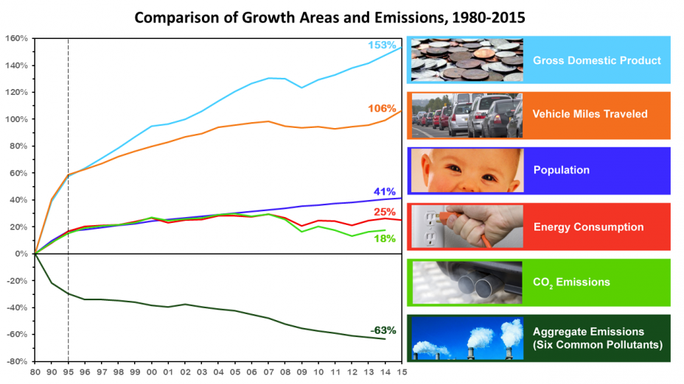
Progress Toward Clean Air since 1970 Pollution Down While Growth Continues
Office of Air and Radiation (OAR)

Slide 6
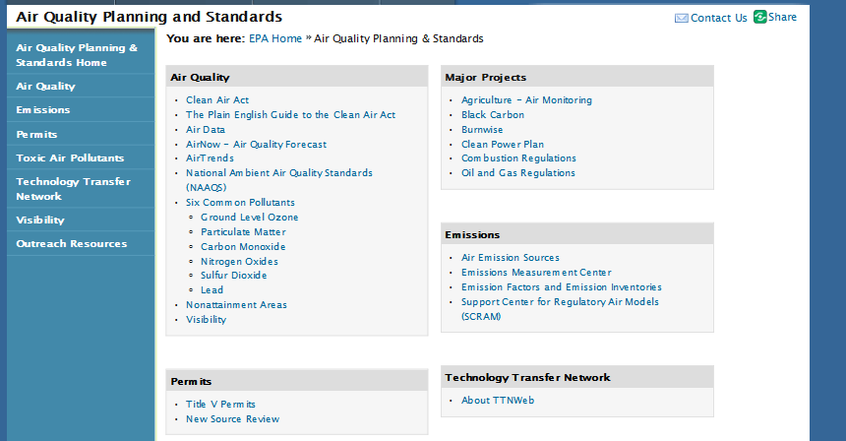
Office of Air Quality Planning and Standards

Slide 7

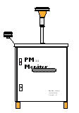
Air Quality Assessment Division (AQAD)
Air Quality Analysis &
Accountability
Air Quality Modeling
Partners
National Emissions Inventory
Ambient Air Monitoring
& Quality
Emissions Analysis
Air & Source
Measurements
Technology
Start Here
Notes:
This slide illustrates the interconnectivity of air quality analyses and the technology that supports data measurements and acquisition.
Starting with how we measure emissions from sources, data and analysis provide interdependent feedback that inform changes in how data are gathered and analyzed around this “data feed back cycle” and between activities.
For example, data from source measurements are used to build emissions inventories that can be used in air quality modeling whose results can be used to make air quality monitoring deployment decisions.

Slide 8
Air Quality Assessment
AQAD
What pollutants are in the air?
Right now, and in the recent past
By hour, day, and longer periods
At monitoring sites, and everywhere else
Where does the air pollution come from?
What sources?
What locations?
Need to untangle atmospheric transport and reactions to figure this out.
How will things change in the future?
What is the potential impact of our policy options?
Do we meet our air quality and program goals?
Notes:
So what do these data and analyses tell us?
They inform us about what is in the air, where pollutants come from, and even what specific sources of air pollution contribute to the air quality we monitor in a particular city or state.
These assessments also tell us how things may change in the future; due to the socio-economic drivers that increase and decrease air pollution and the choices we make as a society to address air quality issues.

Slide 9
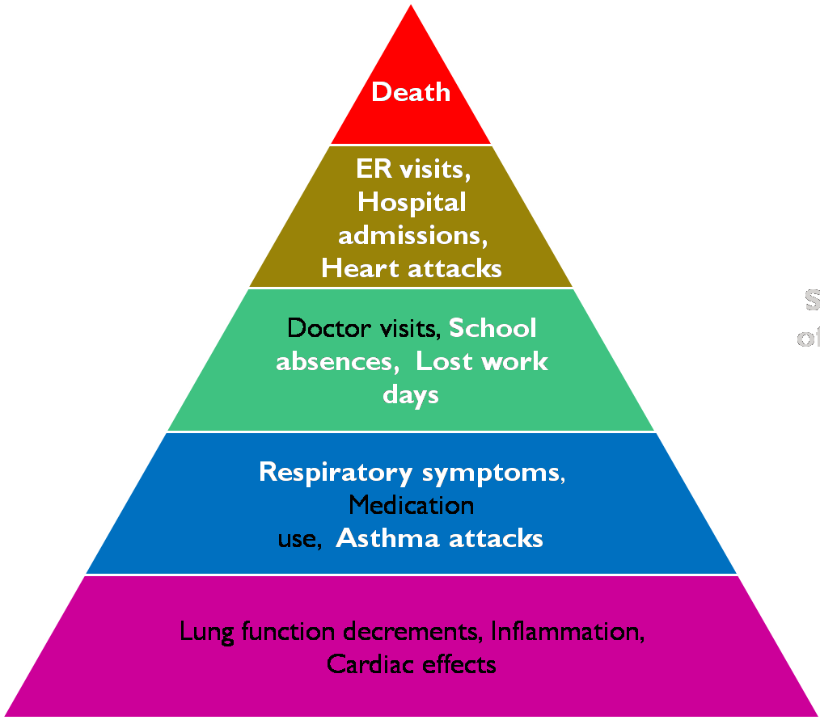
BenMAP
BenMAP: An Open-Source Platform to Quantify the Health Impacts and Economic Value of Stressors – Neal Fann, HEID
Magnitude of impacts
>90% of the monetized benefits
Thousands
Tens of Thousands
Severity of Effects
Millions
Proportion of population affected

Slide 10
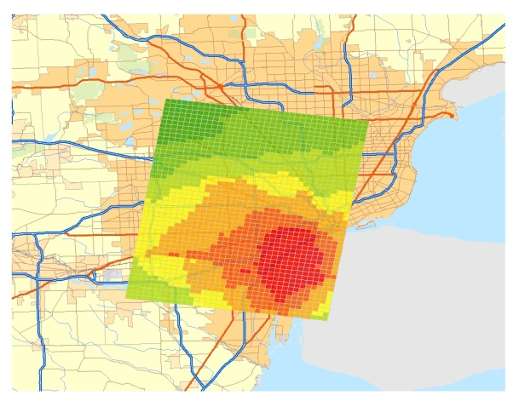
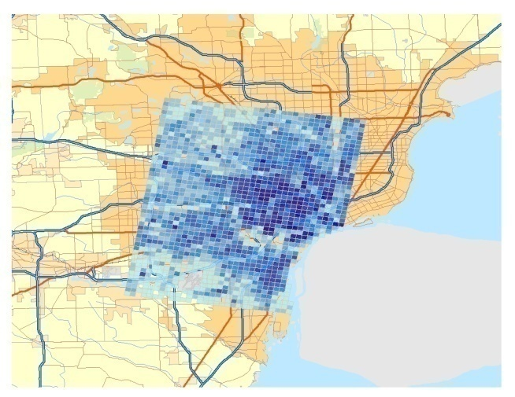
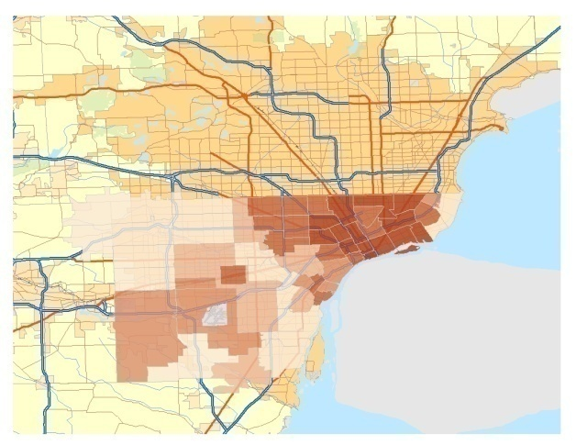
BenMAP
BenMAP: Steps to Calculating Health Impact
∆ Y =
Yo
(1-e
^{-ß∆ PM}
) *
Pop
Pollutant change
Population
Baseline incidence
^{Effect estimate}
Health impact

Slide 11
EPA
Downscaling and Data Fusion:
Spatial Information
Combining Strengths across Data Sources

Slide 12
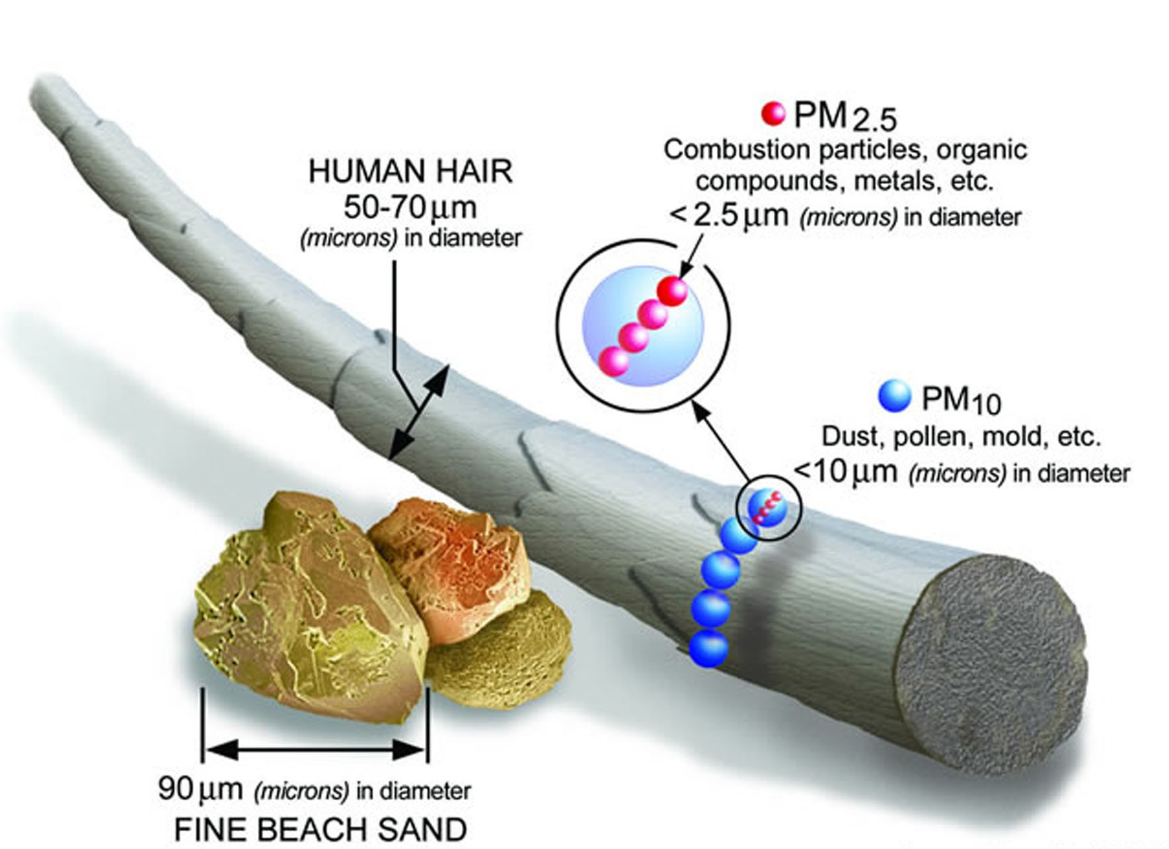
Particulate Matter (PM)

Slide 13

Particulate Matter (PM)
Donora, PA: picture taken at noon on October 29, 1948
20 people died and thousands were sickened

Slide 14
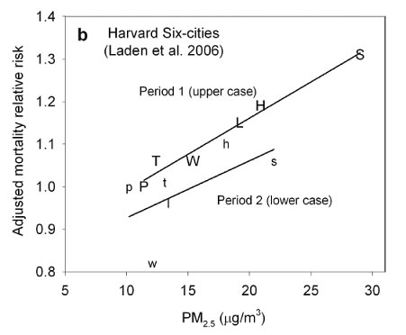
PM_{2.5} Health Impacts

Slide 15
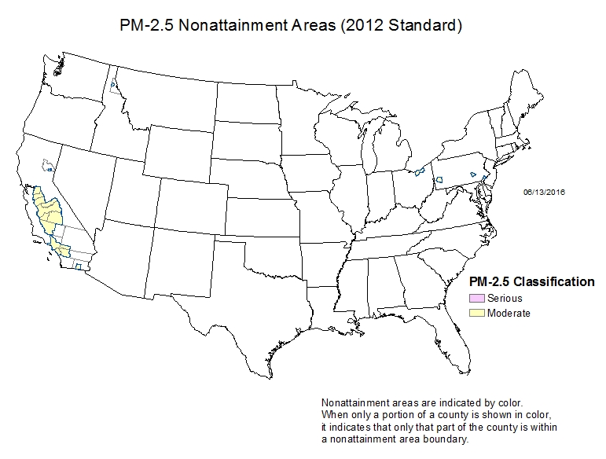
Places with High PM_{2.5}

Slide 16
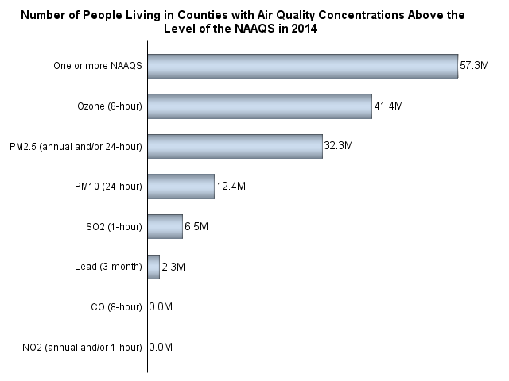
# of People Exposed to High PM_{2.5}

Slide 17
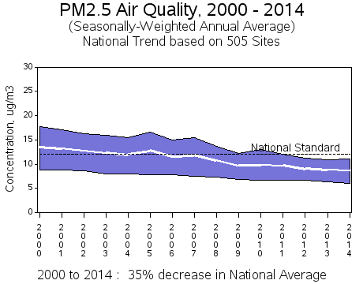
PM_{2.5} Trends

Slide 18
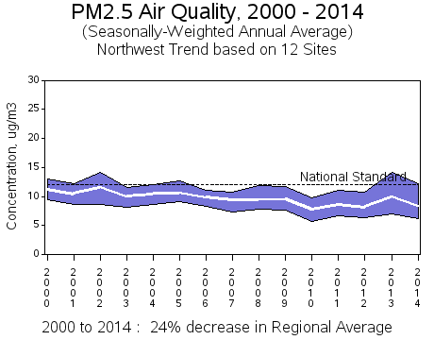
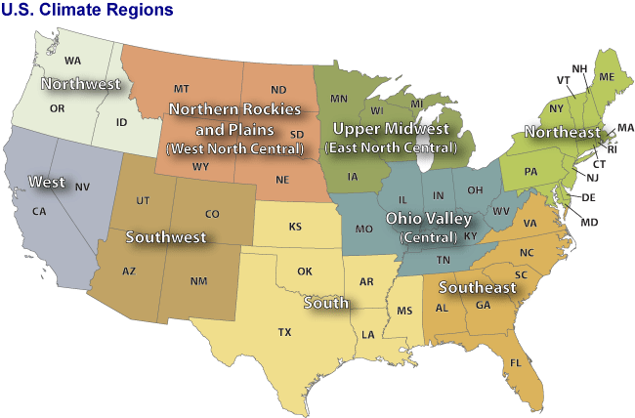
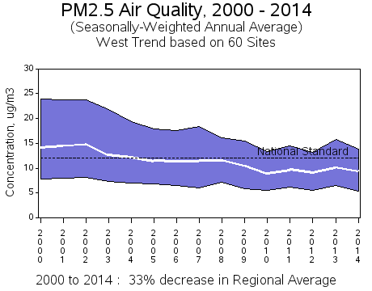
PM_{2.5} Trends

Slide 19
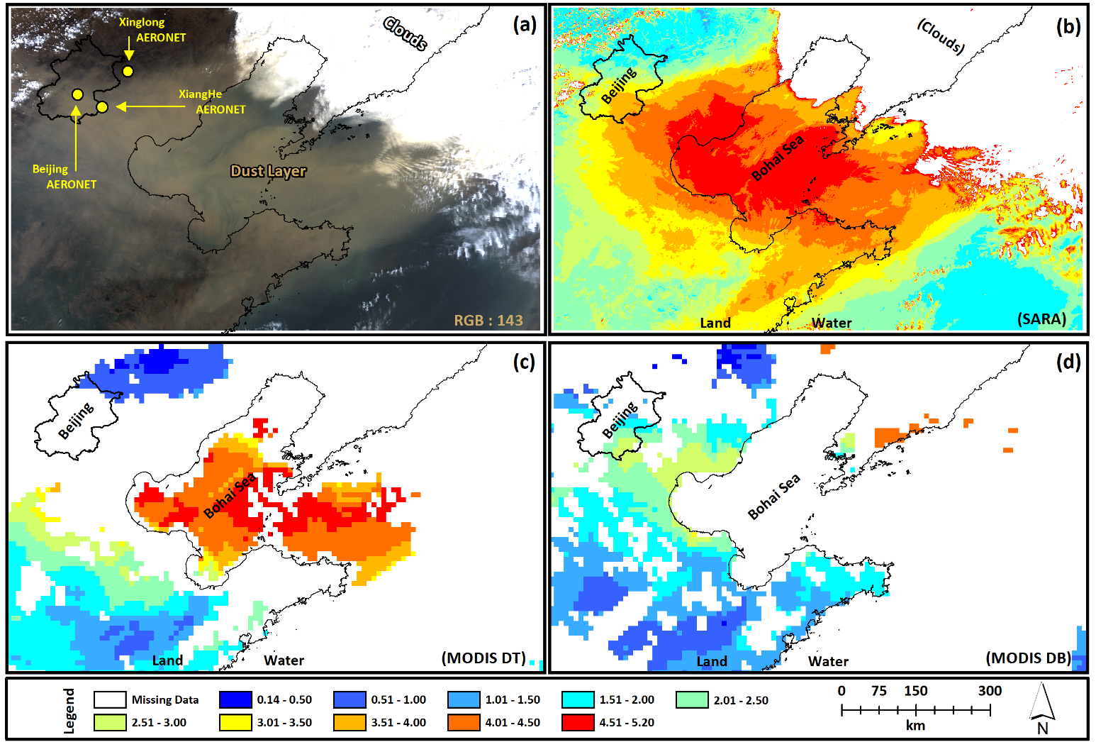
Aerosol Optical Thickness (AOT)
Aerosol optical thickness (AOT) is a measure of the extinction of the solar beam by dust and haze. In other words, particles in the atmosphere (dust, smoke, pollution) can block sunlight by absorbing or by scattering light.

Slide 20
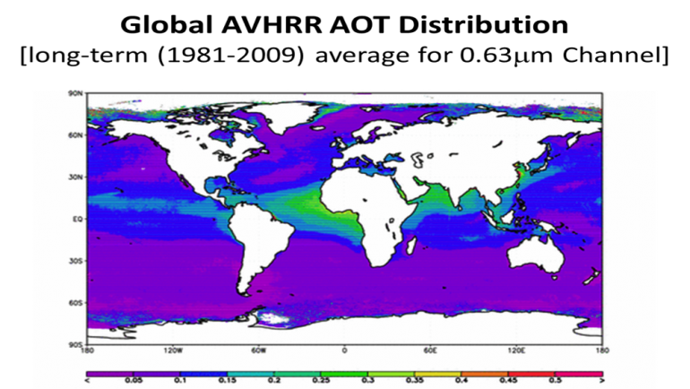
AVHRR AOT
Through careful calibration of data from various Advanced Very High Resolution Radiometer (AVHRR) sensors in space since 1981, NOAA-NCEI has created a Climate Data Record (CDR) of AOT over oceans for use in monitoring and assessing air quality trends.

Slide 21
AOT vs PM_{2.5}
Van Donkelaar et al. (2006)
Several studies have used satellite-derived AOT to estimate surface PM_{2.5} concentrations with varying results.

Slide 22
Our Proposal
IMSM Remote Sensing Data Fusion Project
Fusing surface and satellite-derived PM observations to determine the impact of international transport on coastal PM_{2.5} concentrations in the western U.S.
Brett Gantt, Elizabeth Mannshardt – US Environmental Protection Agency; Jessica Matthews, NOAA/NCEI
While domestic sources of emissions are the primary cause of air pollution in the U.S., the international flow of air pollution into the U.S. contributes to observed concentrations of criteria pollutants such as ozone and particulate matter < 2.5 micrometers in diameter (PM_{2.5}).
The impact that international transport of air pollution has on our ability to attain air quality standards or other environmental objectives in the U.S. has yet to be fully characterized

Slide 23
Our Proposal
IMSM Remote Sensing Data Fusion Project
Goals of this project:
Use long-term aerosol optical depth (AOD) measurements from the Advanced Very High Resolution Radiometer (AVHRR) satellite to determine the impact of international transport of air pollution on PM_{2.5} concentrations in coastal areas of the western U.S.
Fuse this satellite dataset with PM_{2.5} observations and meteorological parameters from the National Centers for Environmental Prediction (NCEP) reanalysis to enable a temporal and spatial extrapolation of the existing monitoring network.
Quantify the spatial gradients and trends in PM_{2.5} affected by international transport to help local and regional areas understand how background levels of these pollutants may affect their ability to achieve the National Ambient Air Quality Standards and long‑term visibility improvement goals.

Slide 24
EPA
Thank you!
Internships: http://www.epa.gov/careers/student-internships
Careers: https://www.usajobs.gov/

